Slide 1
Word Embedding

Slide 2
What is Word2Vec?
Word2Vec creates vectors of the words that are distributed numerical representations of word features – these word features could comprise of words that represent the context of the individual words present in our vocabulary.
Word embeddings eventually help in establishing the association of a word with another similar meaning word through the created vectors.

Slide 3
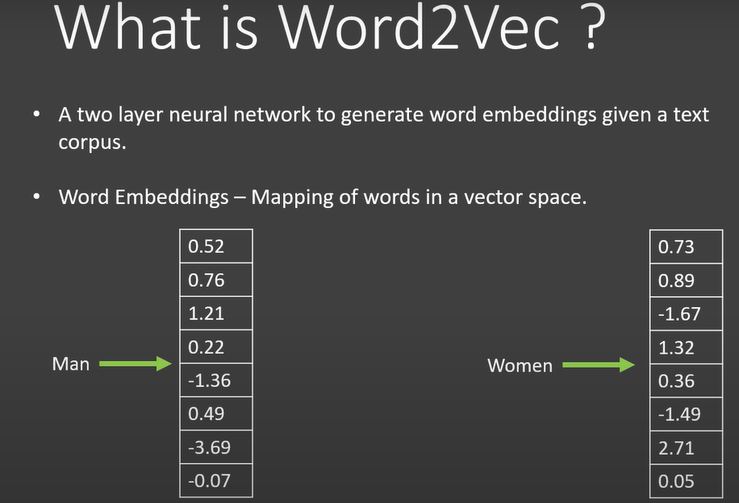

Slide 4
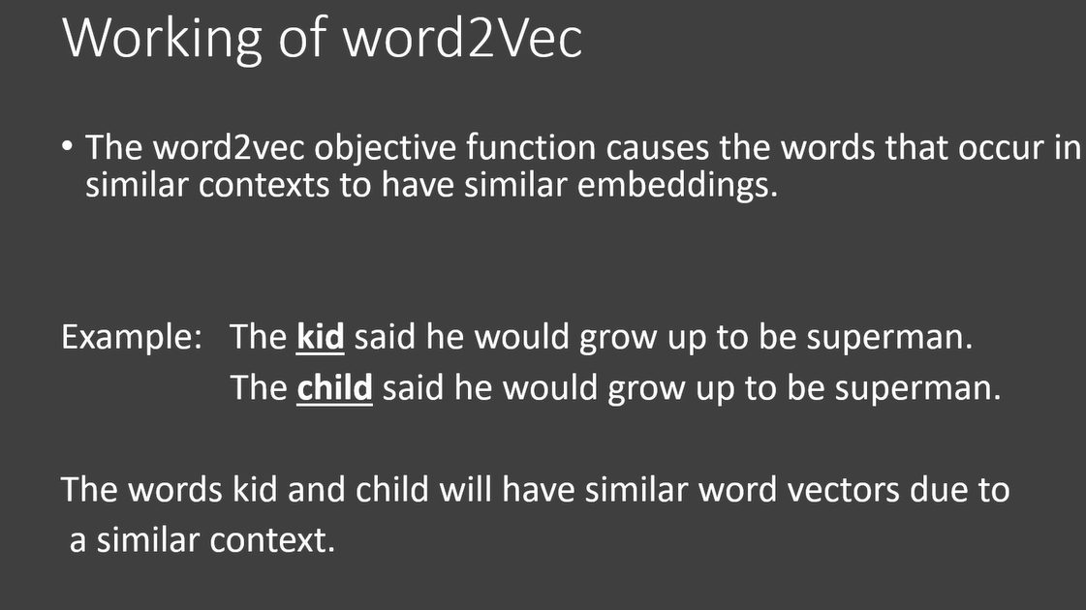

Slide 5
Types:
Two different model architectures that can be used by Word2Vec to create the word embeddings are the Continuous Bag of Words (CBOW) model & the Skip-Gram model.

Slide 6
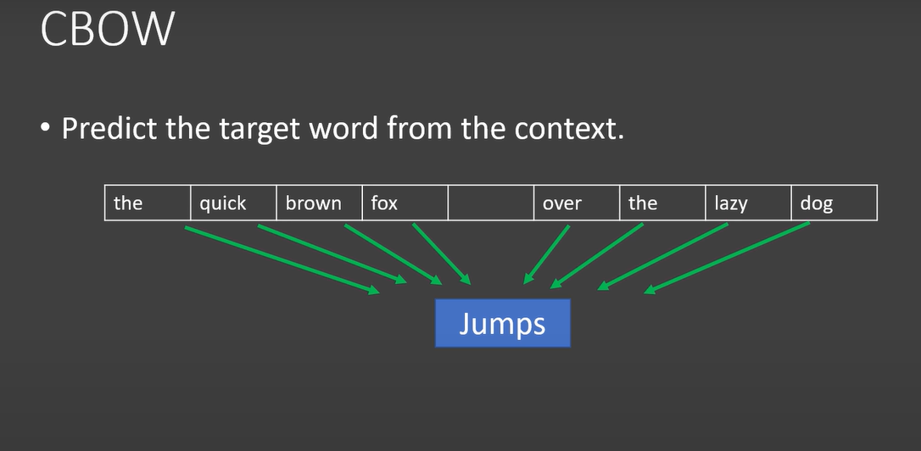

Slide 7
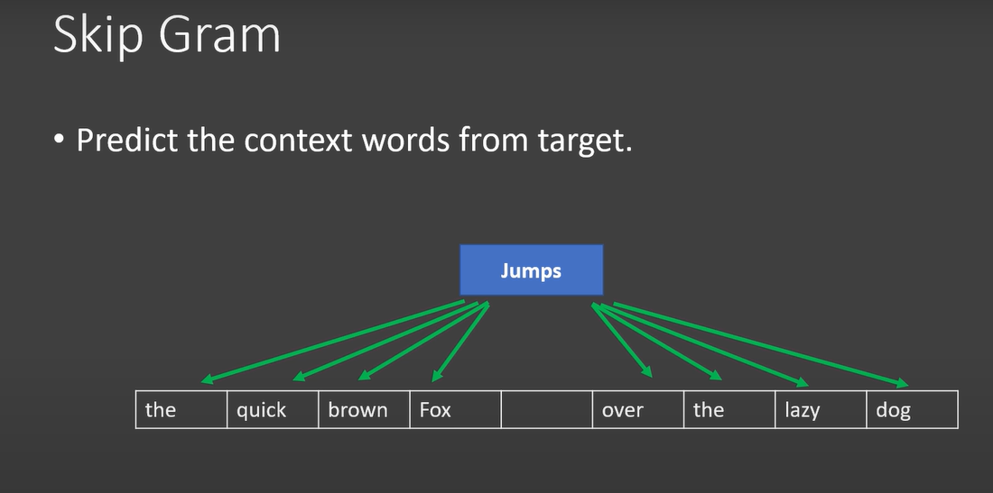

Slide 8
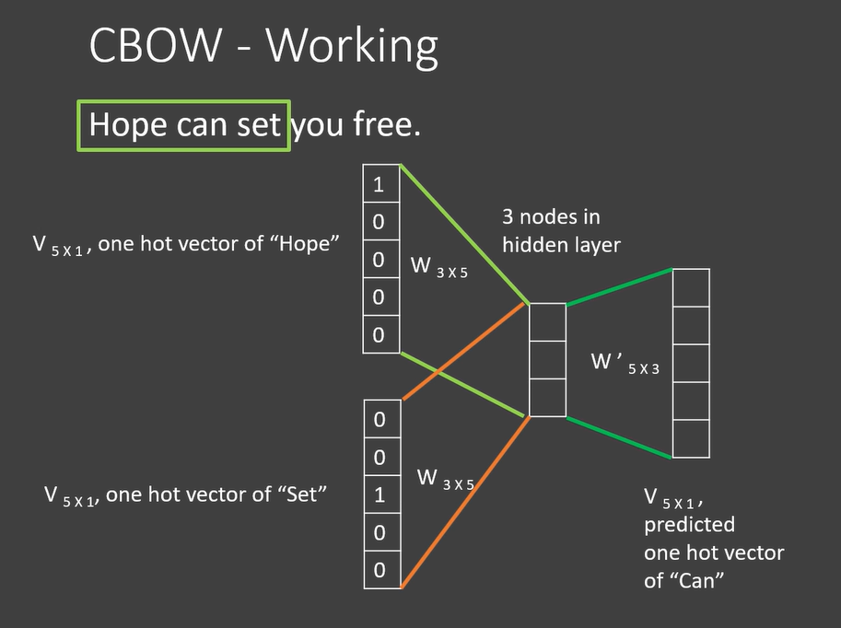

Slide 9
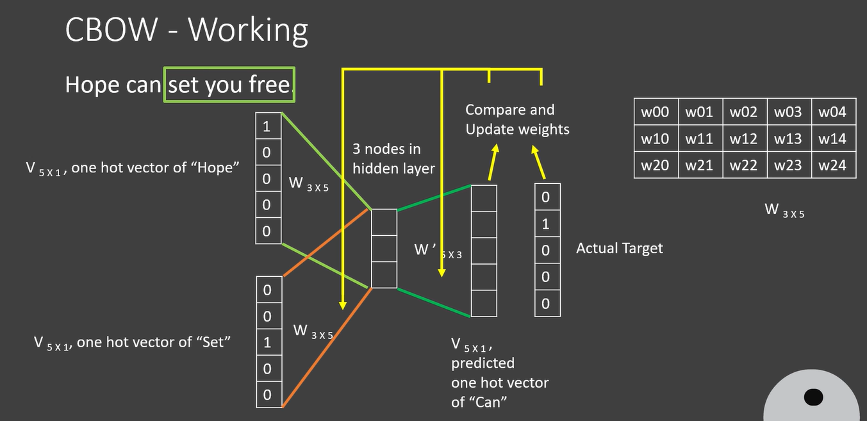

Slide 10
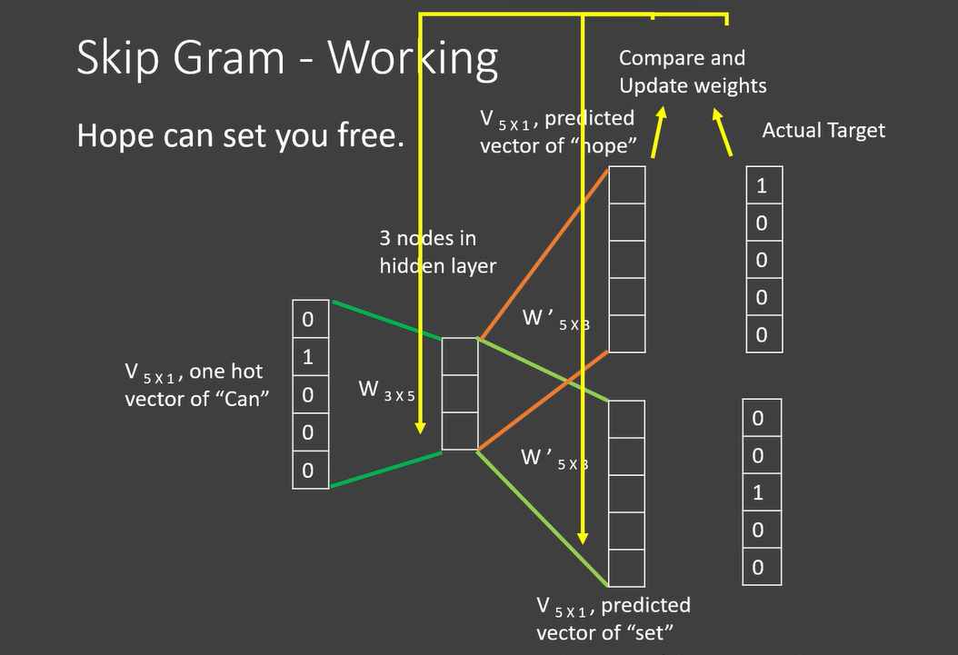

Slide 11
Skip gram:
Skip-gram is used to predict the context word for a given target word. It’s reverse of CBOW algorithm. Here, target word is input while context words are output.

Slide 12
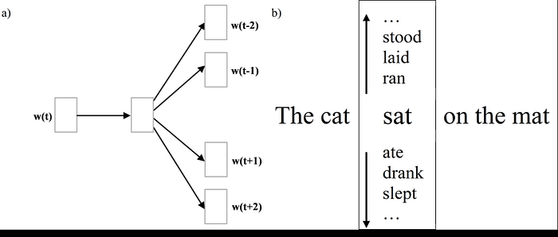

Slide 13
The word sat will be given and we’ll try to predict words cat, mat at position -1 and 3 respectively given sat is at position 0 . We do not predict common or stop words such as the .

Slide 14
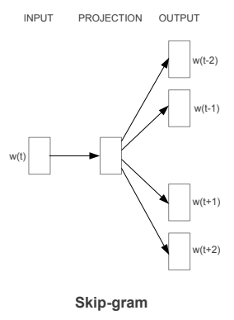
Architecture
As we can see w(t) is the target word or input given. There is one hidden layer which performs the dot product between the weight matrix and the input vector w(t).
No activation function is used in the hidden layer. Now the result of the dot product at the hidden layer is passed to the output layer.
Output layer computes the dot product between the output vector of the hidden layer and the weight matrix of the output layer.
Then we apply the softmax activation function to compute the probability of words appearing to be in the context of w(t) at given context location.
https://towardsdatascience.com/skip-gram-nlp-context-words-prediction-algorithm-5bbf34f84e0c#:~:text=Skip%2Dgram%20is%20one%20of,while%20context%20words%20are%20output.

Slide 15
Discourse and Coherence
Discourse: Discourse refers to how sentences or utterances are connected and organized to convey meaning in a conversation or text. It's about understanding the larger structure and flow of communication beyond just individual sentences. In NLP, analyzing discourse helps in understanding how different parts of a text relate to each other and contribute to its overall meaning.
Coherence: Coherence is about the logical and meaningful connection between ideas or sentences within a text. It's the quality that makes a text easy to understand because the ideas flow smoothly and logically from one to the next. Coherent texts are organized and structured in a way that makes sense to the reader or listener.

Slide 16
Example:
Imagine you're reading a paragraph about the process of making a sandwich:
First, you take two slices of bread. Then, you spread peanut butter on one slice and jelly on the other. Next, you put the two slices together to form a sandwich.
In this example:
Discourse: It's about understanding the sequence of events or steps involved in making a sandwich. Each sentence builds upon the previous one to describe the process.
Coherence: The sentences are logically connected, with each step following naturally from the one before it. The reader can easily understand the progression from taking the bread to assembling the sandwich because the ideas are coherent and flow in a logical order.

Slide 17
“The Tin Woodman went to the Emerald City to see the Wizard of Oz and ask for a heart. After he asked for it, the Woodman waited for the Wizard’s response”
What do pronouns such as he and it denote?
No doubt the reader had little trouble figuring out that he denotes the Tin Woodman and not the Wizard of Oz, and that it denotes the heart and not the Emerald City.
Furthermore, it is clear to the reader that the Wizard is the same entity as the Wizard of Oz, and the Woodman is the same as the Tin Woodman. But doing this disambiguation automatically is a difficult task.
This goal of deciding what pronouns and other noun phrases refer to is called coreference resolution.

Slide 18
Coreference resolution is important for information extraction, summarization, and for conversational agent
Consider the task of summarizing the following news passage:
(21.2) First Union Corp is continuing to wrestle with severe problems. According to industry insiders at Paine Webber, their president, John R. Georgius, is planning to announce his retirement tomorrow.
We might want to extract a summary like the following extract a summary like the following:
(21.3) First Union President John R. Georgius is planning to announce his retirement tomorrow.
In order to build such a summary, we need to know that the second sentence is the more important of the two, and that the first sentence is subordinate to it, just giving background information. Relationships of this sort between sentences in a discourse are called coherence relations, and determining the coherence structures between discourse sentences is an important discourse task.

Slide 19
Concept of Coherence
Coherence in terms of Discourse in NLP means making sense of the utterances or making meaningful connections and correlations.
There is a lot of connection between the coherence and the discourse structure

Slide 20
What are coherent discourse texts?
If we read a paragraph from a newspaper, we can see that the entire paragraph is interrelated;
Hence we can say that the discourse is coherence, but if we only combine the newspaper headlines consecutively, then it is not a discourse, it is just a group of sentences that are also non-coherence.

Slide 21
Coherence Relation Between Utterances
When we say that the discourses are coherent, then it simply means that the discourse has some sort of meaningful connection. The coherent relation tells us that there is some sort of connection present between the utterances.
Relationship Between Entities
If there is some kind of relationship between the entities, then we can also say that the discourse in NLP is coherent. So, the coherence between the entities is known as entity-based coherence.

Slide 22
Discourse Structure
The structure of the discourse depends on the type of segmentation applied to the discourse.

Slide 23
DISCOURSE SEGMENTATION
When we determine the types of structures for a large discourse, we term its segmentation. The segmentation is a difficult thing to implement, but it is very necessary as discourse segmentation is used in fields like :
  Information Retrieval,
  Text summarization,
  Information Extraction, etc.

Slide 24
Discourse Segmentation
Separating a document into linear sequence of sub topics
Discourse Segment: Stretches of discourse in which the sentences are addressing the same topic.
A sequence of clauses that display local coherence
A sequence of clauses possibly interrupted by sub segments forming a hierarchical structure
Each segment is a coherent unit, Should have the following properties:
  Some technique based on recency should be usable in referential analysis handling ellipses
  A simple progression in time and location
  A fixed set of speakers and hearers
  A fixed set of background assumptions

Slide 25
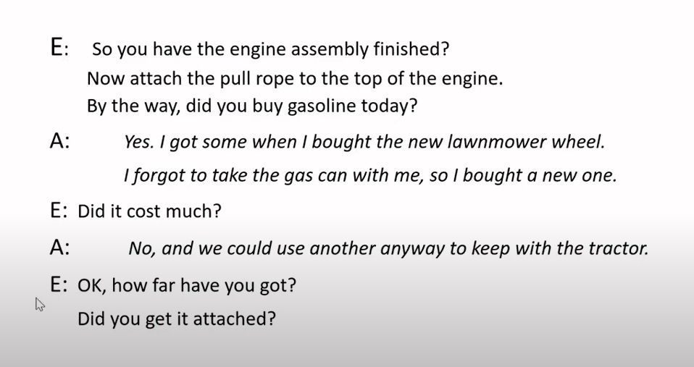

Slide 26
Algorithms for Discourse Segmentation
Unsupervised Discourse Segmentation
Supervised Discourse Segmentation

Slide 27
Unsupervised Discourse Segmentation
The class of unsupervised segmentation is also termed or represented as linear segmentation. Let us take an example to understand this discourse segmentation better.
Suppose we have a text with us, and the task is to segment the text into various units of multi-paragraphs. In the multi-paragraphs, a single unit is going to represent a passage of the text.
Now the algorithm will take the help of cohesion and the algorithm will classify the dependent texts and tie them together using some linguistic devices.
In simpler terms, unsupervised discourse segmentation means the classification and grouping up of similar texts with the help of coherent discourse in NLP.
The unsupervised discourse segmentation can also be performed with the help of lexicon cohesion. The lexicon cohesion indicates the relationship among similar units, for example, synonyms.

Slide 28
Coherence and cohesion are often confused; let’s review the difference.
Cohesion refers to the way textual units are tied or linked together.
A cohesive relation is like a kind of glue grouping together two units into a single unit.
Coherence refers to the meaning relation between the two units.
A coherence relation explains how the meaning of different textual units can combine to jointly build a discourse meaning for the larger unit.

Slide 29
Example:
Lexical cohesion
It is the cohesion indicated by relations between words in the two units, such as use of an identical word, a synonym, or a hypernym.
For example the fact that the words house, shingled, and I occur in both of the two sentences in (21.8ab), is a cue that the two are tied together as a discourse:
(21.8) • Before winter I built a chimney, and shingled the sides of my house...
• I have thus a tight shingled and plastered house
In Ex. (21.9), lexical cohesion between the two sentences is indicated by the hypernym relation between fruit and the words pears and apples.
(21.9) Peel, core and slice the pears and the apples. Add the fruit to the skillet.

Slide 30
Example:
"John had always loved camping. He would often spend weekends in the wilderness, surrounded by towering trees and the sounds of nature. However, this time was different. The weather forecast had predicted heavy rain, and John was concerned about his tent's ability to withstand the storm. Despite his worries, he decided to go ahead with the trip. As he set up camp, dark clouds loomed overhead, and soon enough, the rain started pouring down."

Slide 31
Using these cues, the example text could be segmented into the following clusters:
Segment 1:
  "John had always loved camping."
  "He would often spend weekends in the wilderness, surrounded by towering trees and the sounds of nature."
Segment 2:
  "However, this time was different."
  "The weather forecast had predicted heavy rain, and John was concerned about his tent's ability to withstand the storm."
  "Despite his worries, he decided to go ahead with the trip."
  "As he set up camp, dark clouds loomed overhead, and soon enough, the rain started pouring down."

Slide 32
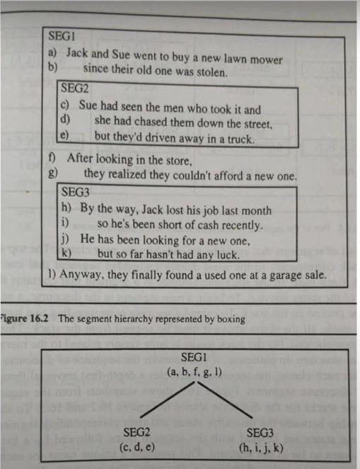

Slide 33
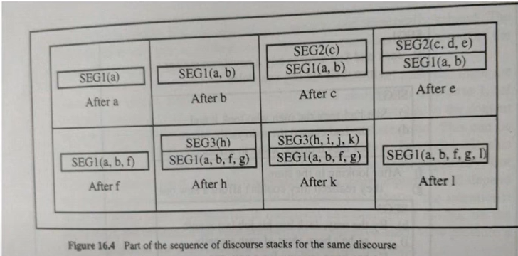

Slide 34
Supervised Discourse Segmentation
In the previous segmentation, there was no certain labeled segment boundary to separate the discourse segments.
But in the supervised discourse segmentation, we only deal with the training data set having a labeled boundary.
To differentiate or structure the discourse segments, we make use of cue words or discourse makers.
These cue words or discourse maker works to signal the discourse structure.
As there can be varied domains of discourse in NLP so, the cue words or discourse makers are domain specific.
A key additional feature that is often used for supervised segmentation is the presence of discourse markers or cue words. A discourse marker is a word or phrase that functions to signal discourse structure.

Slide 35
Example:
"John had always loved camping. He would often spend weekends in the wilderness, surrounded by towering trees and the sounds of nature. However, this time was different. The weather forecast had predicted heavy rain, and John was concerned about his tent's ability to withstand the storm. Despite his worries, he decided to go ahead with the trip. As he set up camp, dark clouds loomed overhead, and soon enough, the rain started pouring down."

Slide 36
Segmented Text:
John had always loved camping.
He would often spend weekends in the wilderness, surrounded by towering trees and the sounds of nature.
However, this time was different.
The weather forecast had predicted heavy rain, and John was concerned about his tent's ability to withstand the storm.
Despite his worries, he decided to go ahead with the trip.
As he set up camp, dark clouds loomed overhead, and soon enough, the rain started pouring down.

Slide 37
Cues and Markers: Cues and markers are linguistic features or patterns that signal the beginning or end of a discourse segment. In the provided example, some cues and markers include:
Transition Words and Phrases: Words like "however," "despite," and "as" indicate shifts in the narrative or introduction of new information.
Punctuation: Periods (.) are often used to denote the end of a sentence and consequently, the end of a segment. However, not all periods signify segment boundaries, as some may occur within sentences.
Temporal and Spatial Indicators: Phrases like "this time," "soon enough," and "as he" provide temporal or spatial context, which can often signal the beginning or continuation of a new segment.
Contextual Cues: In this example, the change in topic from John's love for camping to his concern about the weather serves as a significant cue for segment boundary.

Slide 38
Text Coherence
Lexical repetition is a way to find the structure in a discourse, but it does not satisfy the requirement of being coherent discourse.
To achieve the coherent discourse, we must focus on coherence relations in specific.
As we know that coherence relation defines the possible connection between utterances in a discourse.

Slide 39
Result
We are taking two terms S₀ and S₁ to represent the meaning
It infers that the state asserted by term S₀ could cause the state asserted by S₁.
For example, two statements show the relationship result:
“Ram was caught in the fire. His skin burned.”

Slide 40
Explanation
It infers that the state asserted by S₁ could cause the state asserted by S₀.
For example, two statements show the relationship −
“Ram fought with Shyam’s friend. He was drunk.”

Slide 41
Parallel
It infers p(a1,a2,…) from assertion of S₀ and p(b1,b2,…) from assertion S₁. Here ai and bi are similar for all i.
For example, two statements are parallel −
“Ram wanted car. Shyam wanted money.”

Slide 42
Elaboration
It infers the same proposition P from both the assertions − S₀ and S₁
For example, two statements show the relation elaboration:
“Ram was from Chandigarh. Shyam was from Kerala.”

Slide 43
Occasion
It happens when a change of state can be inferred from the assertion of S₀, final state of which can be inferred from S₁ and vice-versa.
For example, the two statements show the relation occasion:
“Ram picked up the book. He gave it to Shyam.”

Slide 44
Building Hierarchical Discourse Structure
In the previous section, we discussed how text coherence takes place. Let us now try to build a hierarchal discourse structure with the help of a group of statements. We generally create the hierarchical structure among the coherence relations to get the entire discourse in NLP.

Slide 45
Let us consider the following phrases and serially number them.
S1:
Rahul went to the bank to deposit money.
S2:
He then went to Rohan's shop.
S3 :
He wanted a phone.
S4 :
He did not have a phone.
S5:
He also wanted to buy a laptop from Rohan's shop.

Slide 46
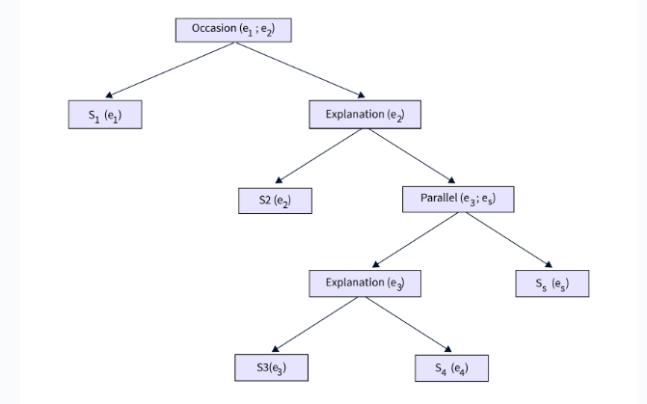

Slide 47
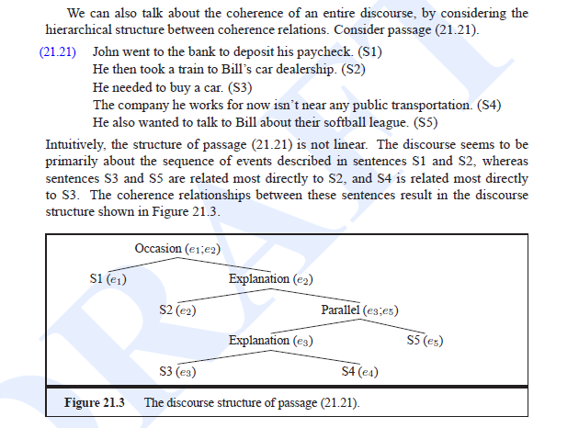

Slide 48
Reference Resolution
The extraction of the meaning or interpretation of the sentences of discourse is one of the most important tasks in natural language processing, and to do so, we first need to know what or who is the entity that we are talking about.
Reference resolution means understanding the type of entity that is being talked about.
By the term reference, we mean the linguistic expression that is used to denote an individual or an entity. For example, look at the below sentences.
Rahul went to the farm.
He cooked food.
His farm was very big.
In the above sentences, Rahul, He, and His references. So, we can simply define the reference resolution as the task of determination of the entities that are being referred to by the linguistic expressions.

Slide 49
Terminology Used in Reference Resolution
Referring expression:
The NLP expression that performs the reference is termed a referring expression.
For example, the passage that we have talked about in the above section is an example of the referring expression.
Referent:
Referent is the entity we have referred to.
For example, in the above passage, Rahul is the referent.
Co-refer:
As the name suggests, Co-refer is a term used for an entity if two or more expressions are referring to the same entity.
For example, Rahul and He is used for the same entity, i.e., Rahul.
Antecedent:
The term that has been licensed to use another term is termed antecedent.
For example, in the above passage, Rahul is the antecedent of the reference He.
Anaphora & Anaphoric:
The referring expression is termed anaphoric.
Anaphora & Anaphoric can be said to be the term or reference used for an entity that has previously been introduced in the same sentence.
Discourse model:
It is the model that has the overall representation of the entities that have been referred to in the discourse text. It also contains the relationship of the involved discourse in the NLP.

Slide 50
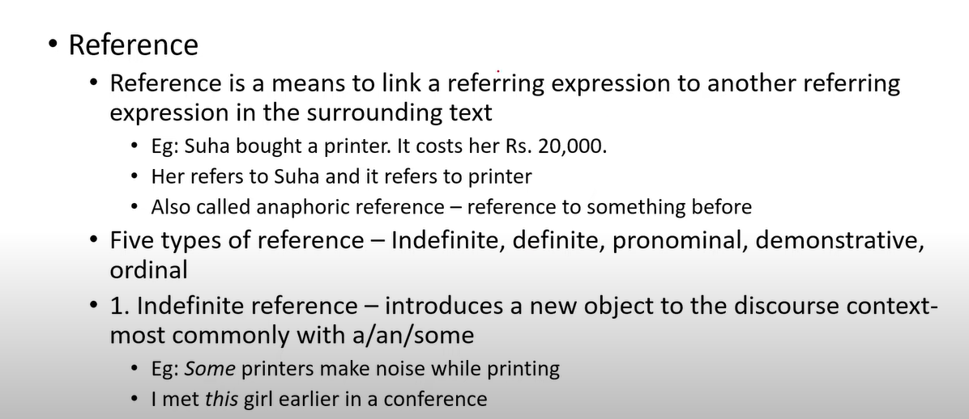

Slide 51
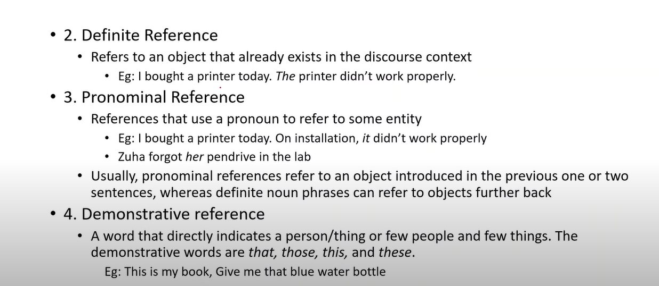

Slide 52
Definite Reference:
Definite reference is used when you are talking about a particular, specific thing that both the speaker and the listener know about or can easily identify. It's like saying "the" something, indicating there's a specific instance of that thing being referred to.
Example: "I saw the cat sitting on the fence." In this sentence, "the cat" refers to a specific cat that both the speaker and the listener are aware of or can easily understand from the context. Similarly, "the fence" refers to a particular fence that is also known or identifiable in the context of the conversation.

Slide 53
Indefinite Reference:
Indefinite reference is used when you are talking about something in a more general or nonspecific way. It's like saying "a" or "an" something, indicating that you're referring to any instance of that thing, not a particular one.
Example: "I want to buy a book." In this sentence, "a book" refers to any book in general, not a specific one. The speaker is expressing a desire to purchase any book, without specifying which book they have in mind.

Slide 54
Demonstrative reference
Imagine you're in a park with a friend, and you see two dogs playing. You want to refer to one of the dogs. You might say:
"That dog is chasing the ball."
In this sentence, "that" is a demonstrative reference that points to a specific dog in the park. It indicates that the dog you're referring to is not close to you but is still visible enough for both you and your friend to identify. The use of "that" helps distinguish the dog you're talking about from other objects or animals in the park.
Let's break it down:
"That": This word points to the specific dog you're referring to. It suggests that the dog is a bit distant from both you and your friend but still visible.
"Dog": This is the noun being referred to, the object of the sentence.
"Is chasing the ball": This part of the sentence describes what the dog is doing. It provides additional information about the action being performed by the dog.

Slide 55
Example – pronominal reference
Original sentence: "John went to the store. John bought some groceries."
In this original sentence, the name "John" is repeated, which can sound repetitive. To avoid this repetition, we can use pronouns for pronominal reference:
Revised sentence with pronominal reference: "John went to the store. He bought some groceries."
In this revised sentence, the pronoun "he" is used to refer back to the previously mentioned noun "John." By using the pronoun, we maintain clarity and coherence while avoiding unnecessary repetition.
Pronominal reference is a fundamental aspect of language that allows speakers and writers to communicate efficiently and effectively by referring back to previously mentioned entities in a sentence or discourse.

Slide 56
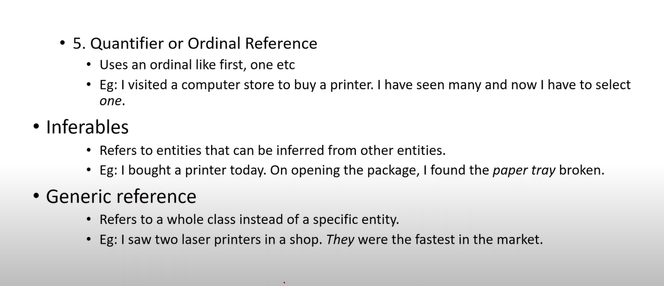

Slide 57
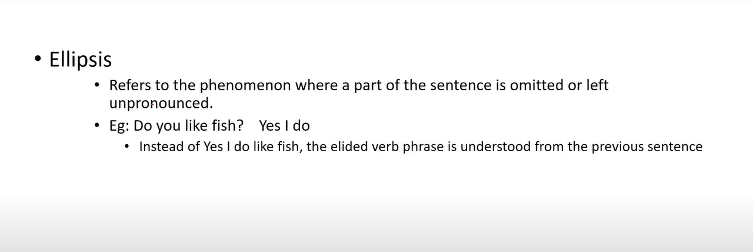

Slide 58
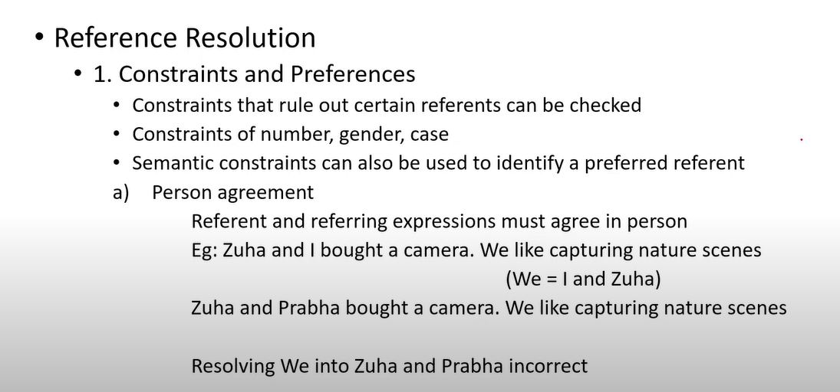

Slide 59
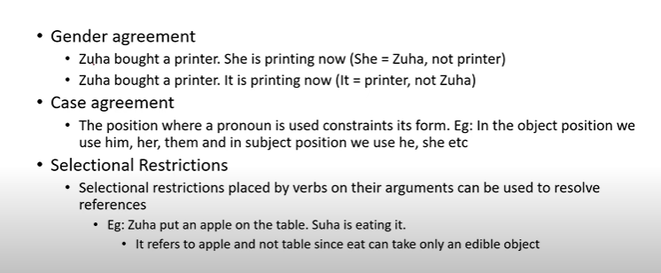

Slide 60
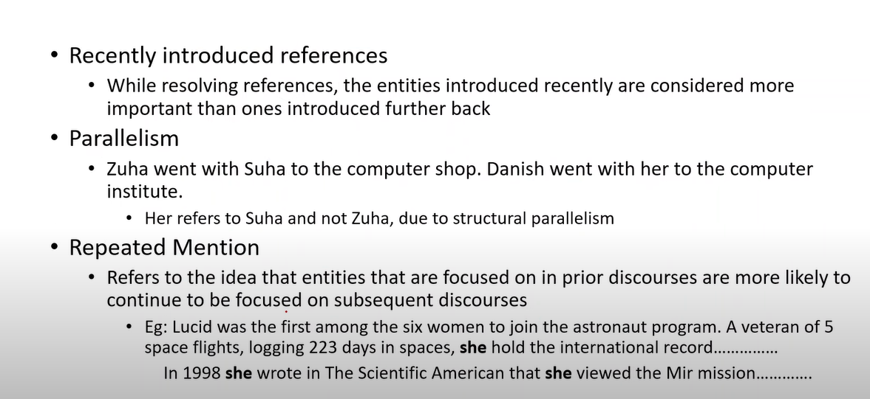

Slide 61
Pronominal Anaphora Resolution:
Pronominal anaphora resolution specifically deals with resolving pronouns to their antecedents.
Anaphora refers to the use of a pronoun to refer back to a previously mentioned noun or noun phrase (antecedent).
Example: "The cat sat on the mat. It droned happily."
Here, "It" is a pronoun referring back to the noun "cat" mentioned earlier. Pronominal anaphora resolution involves identifying the antecedent ("cat") to correctly interpret the meaning of the pronoun ("it").

Slide 62
Coreference Resolution:
Coreference resolution is a broader concept that encompasses the resolution of not only pronouns but also other types of referring expressions that refer to the same entity in a text. This includes noun phrases, proper names, and more.
Example: "John met Mary at the park. He gave her a book. Mary thanked him."
In this example, "John" and "He" refer to the same entity, as do "Mary" and "her," and "John" and "him." Coreference resolution involves identifying and linking these expressions to the appropriate antecedents to establish the relationships between them.

Slide 63
REFERENCE RESOLUTION
(21.34) Victoria Chen, Chief Financial Officer of Megabucks Banking Corp since 2004, saw her pay jump 20%, to $1.3 million, as the 37-year-old also became the Denver-based financial-services company’s president. It has been ten years since she came to Megabucks from rival Lotsabucks.
In this passage, each of the underlined phrases is used by the speaker to denote one person named Victoria Chen. We refer to this use of linguistic expressions like her or Victoria Chen to denote an entity or individual as reference.
Reference resolution is the task of determining what entities are referred to by which linguistic expressions.
A natural language expression used to perform reference is called a referring expression, and the entity that is referred to is called the referent.

Slide 64
Reference Resolution
1. Resolution: Resolution in natural language processing (NLP) refers to the process of resolving linguistic ambiguities or references within a text. This includes resolving pronouns, references to entities, or resolving syntactic ambiguities. It helps in understanding the intended meaning of a sentence or a discourse.
Example: "John visited Mary at her house. He brought her a gift."
In this example, the word "her" in the second sentence is ambiguous. It could refer to Mary or to another female entity previously mentioned or implied. Resolution involves determining which entity the pronoun "her" refers to. In this case, resolution would clarify that "her" refers to Mary, resulting in a coherent understanding of the sentence.

